Slide 1
The Battle of Neighborhoods
IBM Capstone Project

Slide 2
Problem Statement
Suppose, you are looking to invest in some firm in a city/neighborhood.
Where would you want to go to learn about that place to make a safe investment?
This project helps those investors to give an idea and a picture of how well the businesses are going in that area, and a clarity of where to invest the money.
Now, any person who wants to invest in any business can look up at this data to understand and decide where they will invest their investments.

Slide 3
Demo of how the project works
Let’s say that you want to invest in a firm in Toronto.
You want to know what businesses are presently existing in those neighborhoods, how many businesses are there in each category and how well they are doing.
So, now we will use the data acquired from the links to form a dataframe and use it accordingly to arrive to a solution based on the investor needs.

Slide 4
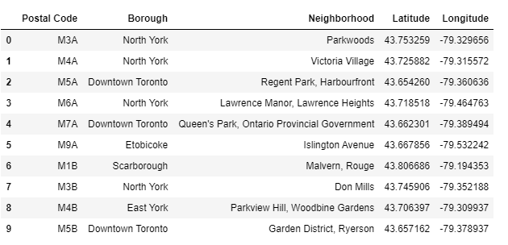
Coordinated Data Frame
DataFrame 1. Coordinates of Respective Neighborhoods

Slide 5
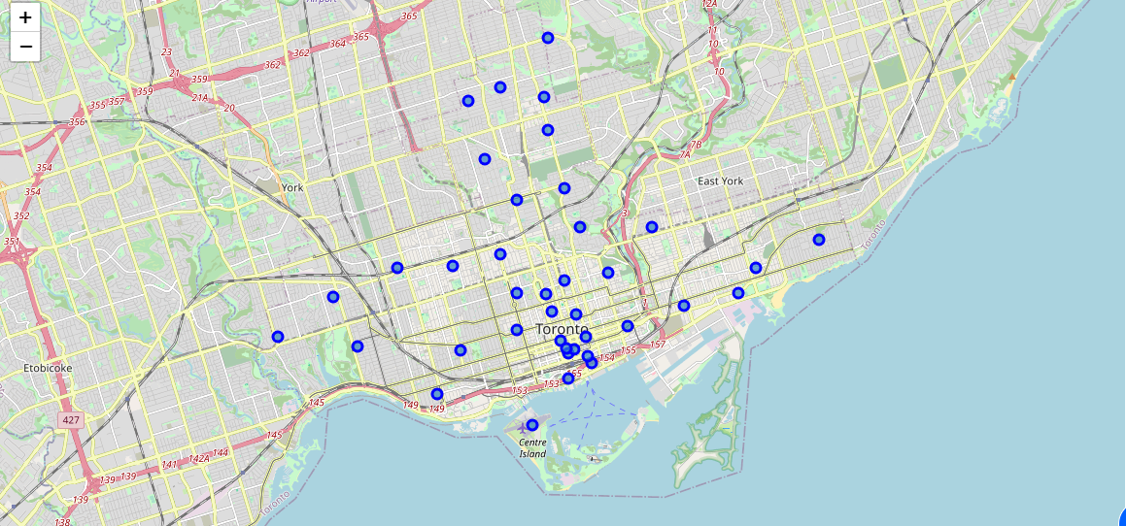
Map of Neighborhoods
Map 1. Toronto Neighborhoods

Slide 6
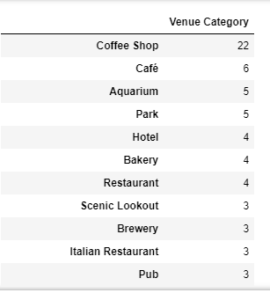
Harbourfront Neighborhood
DataFrame 2. Top Venues in Harbourfront Neighborhood

Slide 7
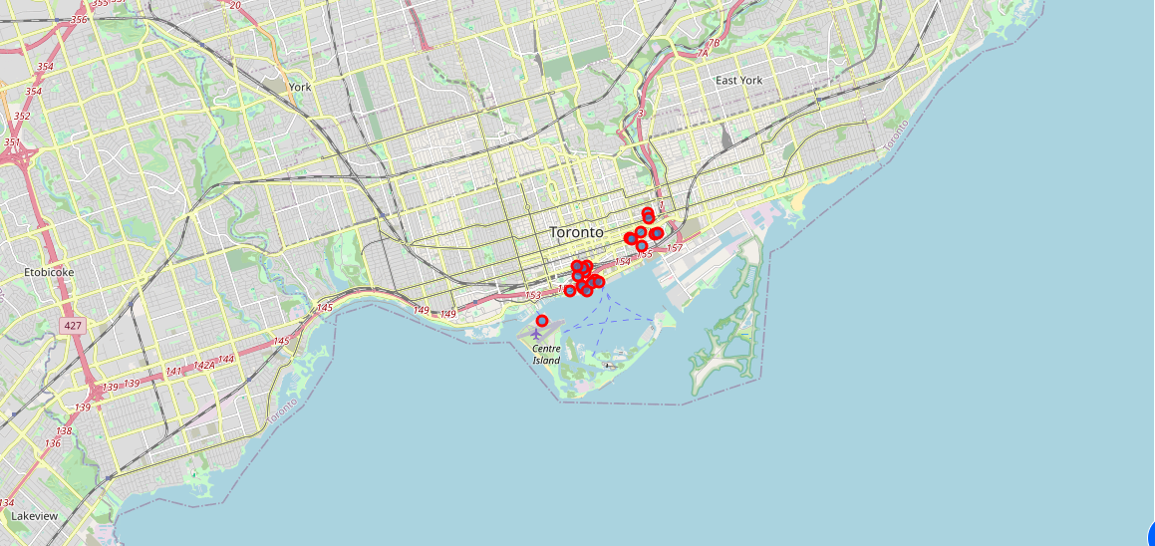
Map of Venues-Harbourfront Neoghborhood
Figure 4. Coffee Shops in Harborfront Neighborhood

Slide 8
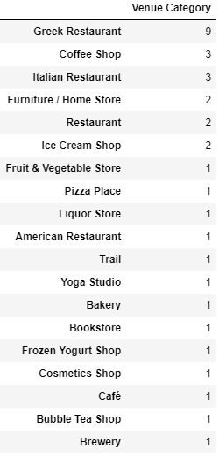
Riverdale Neighborhood
DataFrame 3. Top venues in Riverdale

Slide 9
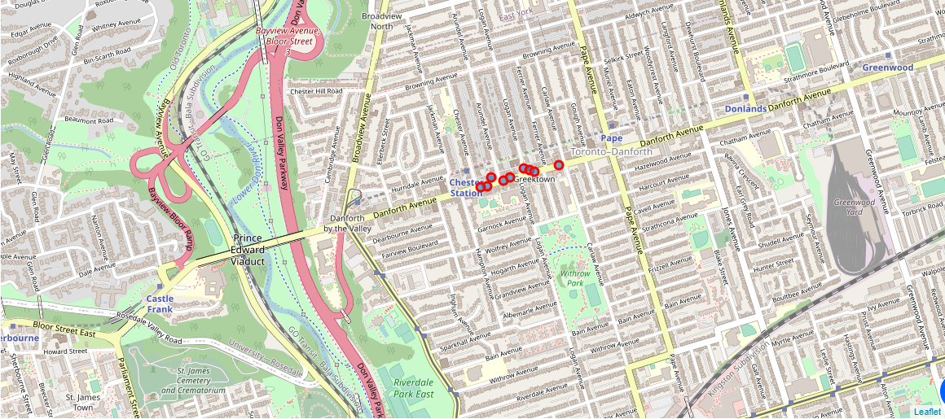
Map of Riverdale Venues
Map 4. Greek Restaurants present in Riverdale

Slide 10
Conclusion
In the above manner, we can arrive to conclusions on where we can invest the money, on which neighborhood, on which venue in that neighborhood and how much we can invest and so on.
We can even apply the above project to compare cities with the appropriate data.
The data for the above dataframes was taken from:
https://en.wikipedia.org/wiki/List_of_postal_codes_of_Canada:_M
https://cocl.us/Geospatial_data

Slide 11
THANK YOU
Done by :
Lalitha Manoj Kumar Banisetty

